Slide 1

Predicting Customer Bookings with Random Forest
BY
AKASSH MANIKANDAN
MS In Advanced Computer Science
University of Leicester

Slide 2
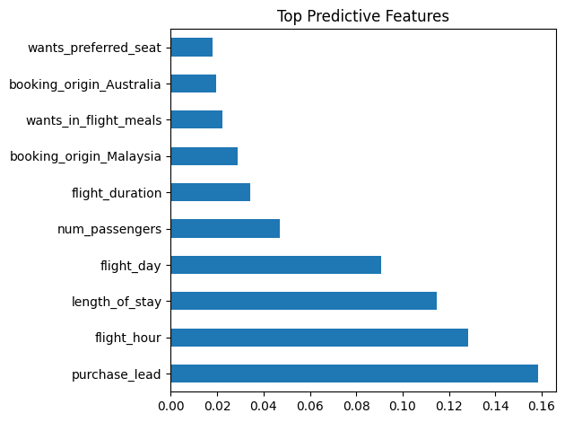
SUMMARY
Metric | Score
Accuracy | 85.3%
Cross-Validation | 70.6%
Precision (booking) | 52%
Recall (booking) | 14%
Objective
Use customer session and preference data to predict whether a user will make a booking.
Model Used
Random Forest Classifier
Chosen for feature importance interpretability and non-linear pattern handling.
Model predicts non-booking better due to class imbalance.
Business Insight:
Users who book earlier, fly mid-day, or stay longer are more likely to complete bookings. Seat preference and meal selection had low impact. Target users with short lead times and mobile sessions with reminders or urgency banners.
Top Predictive Features
Purchase Lead Time
Flight Hour
Length of Stay
Flight Day
Number of Passengers
Persona Simulation
Example User:
Booked 20 days early, 2 passengers, flying at 3 PM
→ Model: Booking Likely
Another User:
Last-minute search, flying at night, 1 passenger
→ Model: No Booking Likely

